Slide 1
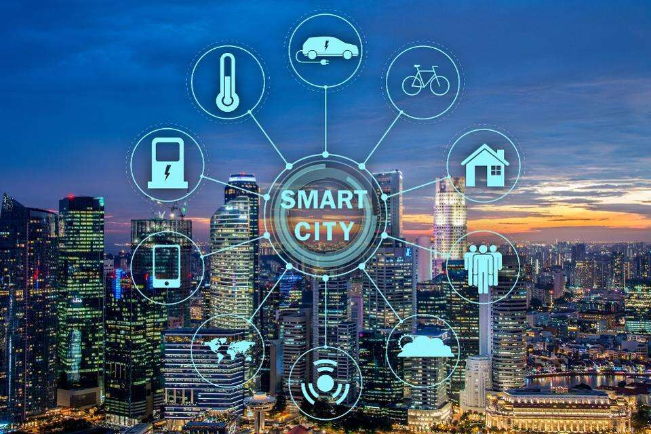
CivicConnect: Smart Public Grievance Tracking System
An Intelligent Platform for Efficient Civic Issue Reporting and Resolution
Presented By :Sejal Heda (2510030350)
Bhavya Potnuru(2510030379)
Thota Lakshmi Hansika(2510030330)
Bachangari Siri(2510030325)
Macharla Mounika(2510030343)
Project Guide : Dr.P Lalitha Surya Kumari
Department of Computer Science & Engineering

Slide 2
Problem Statement
Current Challenges
⏳ Delayed Resolution – Complaints are processed manually, causing slow response times.
🔁 Duplicate Complaints – The same issue is reported multiple times, creating redundant records.
👁️ Lack of Transparency – Citizens cannot easily track the progress of their complaints.
🚨 No Priority-Based Handling – Critical issues are not always resolved before less urgent ones..
🗑️ Garbage ⚡ Electric Pole 🛣️ Road Damage 💧 Water Leakage
📝 Manual Complaint
👤 Citizen
📱 CivicConnect
🤖 Automatic Department Assignment
👤 Citizen
✅ Complaint Resolved
🏢 Department
⭐ Priority Calculation
❌ Unresolved Issue
Delay / Duplicate Complaints
Existing System
Proposed System

Slide 3
Objectives
🎯 Primary Objective: Build a centralized civic complaint management system.
🎯 Centralized Complaint Platform
📝 Easy Complaint Registration
🔁 Duplicate Complaint Detection
🏢 Automatic Department Assignment
⭐ Priority-Based Handling
📊 Real-Time Status Tracking
Expected Improvements:
✅ Reduced complaint duplication
✅ Faster issue resolution
✅ Better transparency for citizens
✅ Improved departmental efficiency
✅ Organized and scalable complaint management

Slide 4
Technology Stack
Component | Technology Used
Frontend | HTML, CSS, JavaScript
Backend | Python (Flask)
Database | MySQL
Database Tool | MySQL Workbench
IDE | Visual Studio Code
Version Control | Git & GitHub
Maps (Optional) | Google Maps API
System Architecture
Citizen
↓
Frontend
(HTML/CSS/JS)
↓
Backend
(Flask)
↓
MySQL Database
↓
Department Dashboard

Slide 5
Expected Outcome
✅ Provide a centralized platform for citizens to report civic issues.
🏢 Automatically assign complaints to the appropriate government department.
🔁 Reduce duplicate complaints by identifying complaints with the same category and location.
⭐ Prioritize critical issues using automatic priority calculation.
📊 Allow citizens to track complaint status in real time.
⚡ Improve the efficiency and response time of government departments.
Benefits
👥 For Citizens
Easy complaint registration
Transparent complaint tracking
Faster issue resolution
Improved communication with departments
🏢 For Government Departments
Organized complaint management
Priority-based resolution
Reduced duplicate records
Better resource allocation

Slide 6
Project Modules
1. Citizen
Registration
Secure registration
& login
2. Complaint
Registration
Category
Location
Description
3. Duplicate Check
& Priority
Detect duplicates
Calculate priority
4. Department
Assignment
Auto-route to
concerned dept.
5. Status
Tracking
Pending
In Progress
Resolved
Workflow
Citizen → Complaint → Duplicate Detection → Priority Calculation → Department Assignment → Status Update → Resolved

Slide 7
Categories & Smart Priority
Automatic Priority Levels
🔴 Critical (10): Fallen electric pole, Fire hazard, Gas leakage
🟠 High (8-9): Garbage near hospital, Road damage near school, Traffic signal failure
🟡 Medium (5-7): Water leakage, Drainage blockage, Animal issues
🟢 Low (1-4): Streetlight failure, Park maintenance, Public cleanliness
Priority Score = Base Priority + Location Bonus + Duplicate Count
Location Bonus:
Hospital +4
School +3
Highway +3
Market +2
Residential Area +1
Others +1
If duplicate complaints are found, the system increases the Priority Score automatically.
Complaint Categories
• 🗑 Garbage & Cleanliness
• 💡 Electricity
• 🛣 Roads & Footpaths
• 💧 Water Supply
• 🚰 Sewerage & Drainage
• 🌳 Parks & Trees
• 🐕 Animal Issues
• 🚦 Traffic & Transport
• 🏗 Building & Construction
• 🌍 Environment
• 🏥 Public Health
• 🚒 Safety & Emergency
• 🏢 Public Infrastructure
• 📢 Other Complaints

Slide 8
Project Plan
Phase | W1 | W2 | W3 | W4 | W5 | W6
Requirement Analysis | ✔
Literature Survey | ✔ | ✔
Database Design |  | ✔
UI & Backend Development |  |  | ✔ | ✔
Testing & Bug Fixing |  |  |  |  | ✔
Documentation |  |  |  |  | ✔ | ✔
Review-2 Preparation |  |  |  |  |  | ✔
Final Review |  |  |  |  |  | ✔

Slide 9
THANK YOU
Questions & Suggestions are Welcome

